Slide 1
Particle Filtering
Edward Wang, Ph.D.

Slide 2


From Particles to Distribution
Vibration sensor measurement
Expert #1：
2.5 mm
Expert #1：
80% Trust
Vibration RMS: 0.2 V
Trust
Objective: to estimate crack length, ? mm
Expert #2：
3.2 mm
Expert #2：
75% Trust
Data-driven vibration-crack relationship
…
…
Expert #N：
1.8 mm
Crack length: 2.8 mm
Expert #N：
20% Trust
2
3
crack
Initial particle generation
Particle: expert
Particle’s value: crack estimation by expert
Particle weight generation
weight: expert’s trustworthiness
By comparing to sensor data
Distribution generation
Distribution: statistical sum of experts’ estimations
May or may not be Gaussian
The probability distribution provides a measure of uncertainties from experts’ experience and sensor measurement
Notes:
This is the first slide to introduce/define what PF is. The slide indicates that particle can be regarded as a human expert. But by definition, what IS a particle, exactly? Do we call it an “agent”? Or a virtual something …?
PW: particle is actually a data point.

Slide 3
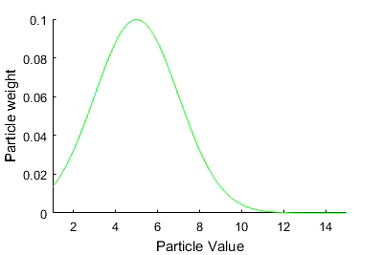
From Particles to Distribution: Illustration
Particles initially sampled from a “guessed” distribution, e.g. uniform U(0, 10)
Weight update
given a new measurement value z=5
Each particle is characterized by two attributes: value (x^{i}) and weight (w^{i})
Particles’ weights contribute to estimation of probability at certain values
Weights initially assigned to be equal
Statistical sum of particles’ locations forms the estimated distribution
Estimation accuracy (resolution) increase with increase of particle number
The accuracy of “guessed” distribution affects PF performance
Posterior PDF to be estimated
e.g. normal distribution N(5, 2)
Notes:
N(5,2): mean value is 5, Std. dev. Is 2
Initial weight assignment: weight of individual particle X number of particles = 1
The process shown in the slide graphly describes sequential importance sampling (SIS)

Slide 4
Effect of Particle Number on Accuracy
Random Samples
Estimated Distribution
1,000 particles
200 particles
5,000 particles
10,000 particles
500 particles
Distribution
Histogram
Weight
Example: particles sampled from a Gamma distribution Gamma (4, 1)
Statistical sum of particles’ locations forms the estimated distribution
More particles sampled
→ estimated distribution curve is more smooth
→ estimated distribution is closer to the theoretical one

Slide 5
Particle Filter
System performance degradation
Each particle describes a specific state value and two parameters
System state (e.g. tool wear) at a certain time is the statistical sum of values from a chosen number N of particles, expressed as a probability distribution
Particles’ weights recursively updated given historical measurement
State propagation is predicted as progressive calculations upon prior PDF and lastly updated weights
Failure threshold
Recursively updated
Computed from prior knowledge
Measurements
Time, t (Min)
Current time
Predicted PDF of remaining life

Slide 6
Particle Filter: Importance Sampling
Sampling particles from a posterior PDF to be estimated: not possible!
Alternative approach: sampling from a importance density function (IDF) q
IDF: even distribution
probability
Weights of particles (importance of particles) updated as
state
weight
Particle value
New meas.
Good choice of IDF: prior PDF, hence weight update is only related to likelihood function, easy to implement
weight
Particle value

Slide 7
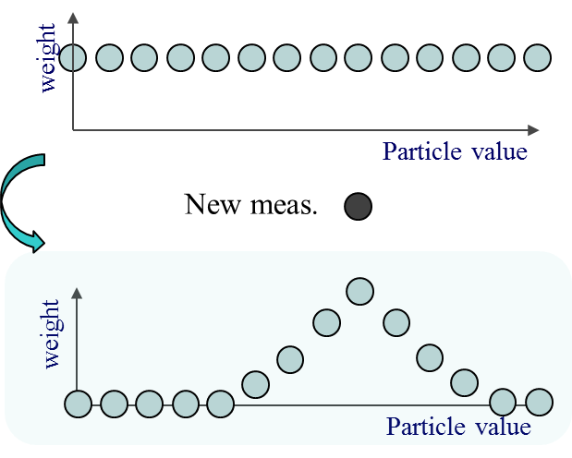
Sampling Degeneration
Likelihood calculated from the distance between new meas. and predicted meas. g(x)
The larger likelihood, the larger updated weight
Particle degeneracy problem: caused by the mismatch between guessed prior PDF and posterior PDF
weights concentrate on a few particles, with rest particles contribute nothing to estimation but still consume computing resource
Candidate solution: resampling, removing particles with small weight

Slide 8

Sample Degeneration: Illustration
Posterior PDF to be estimated
Sampled particles
Weight update @ 1st iteration
Sampled particles
Weight update @ 1st iteration
PF performance varies with the accuracy of the “Guessed” distribution from which particles are sampled
Notes:
Prior pdf to be estimated N(5,2)
20 particles sampled from [0 10] even distribution; particles are described by two attributes: particles’ values and particles’ weights
With new measurement, particles’ weights are updated. The statistical sum of particles is the estimation of the posterior PDF.
The prerequisite for good estimation is that distribution form which particles are sampled from and the distribution to be estimated should be within the same range. However, in reality, we cannot make a perfect guess. I will introduce in the following.
Another question should be pay attention is the particles’ number. The more particles, the better estimation resolution.

Slide 9
Particle Filter: Resampling
Sample degeneracy : caused by the mismatch between prior and posterior PDF
IDF: even distribution
Resampling introduced to improve numbers of active particles and computing efficiency
Sequential Importance Resampling (SIR): comparing particles’ weights to a random number within 0~1to determine particles’ importance
Particle impoverishment problem: single particle may be selected for multiple times
The fact that positions of particles remain same since initial sampling is not addressed
state
weight
Particle value
New meas.
weight
Particle value
weight
Particle value
Arulampalam, A tutorial on particle filter, IEEE Trans. Signal Processing, 2002
Notes:
Resampling: eliminate particles with small weights and keep particles with large weights, implemented by comparing particles’ weights to random numbers.

Slide 10
Flowchart of Generic PF
Measure of degeneracy: effective sample size
Initialize PF Parameters
Propose Initial Population , <x₀,w₀>
Resample whenever
Propagate Particles using State Model , x_{k-1}→x_{k}
Measurement
z_{k}
Update Weights, w_{k-1}→w_{k}
Weights degenerated?
No
Yes
Resample

Slide 11
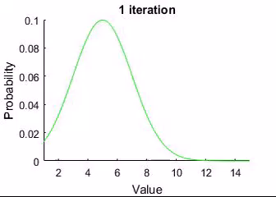
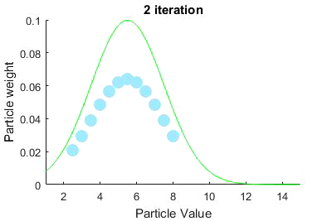
Particle Impoverishment vs. Time-Varying System
Posterior PDF to be estimated:
A shifting normal distribution, with mean value shifted from 5 to 9.5 in 10 iterations
Particles initially sampled form a “guessed” distribution:
Uniform distribution U(0, 10)
Weight update by standard PF
Given measurement 5 @ 1st iteration, 5.5 @ 2nd iteration,…, 9.5 @ 10th iteration
Root cause for particle impoverishment
Particles’ positions remain the same in the resampling
Particles cannot follow the variation of the posterior PDF
Notes:
Prior pdf to be estimated N(5,2)
20 particles sampled from [0 10] even distribution; particles are described by two attributes: particles’ values and particles’ weights
With new measurement, particles’ weights are updated. The statistical sum of particles is the estimation of the posterior PDF.
The prerequisite for good estimation is that distribution form which particles are sampled from and the distribution to be estimated should be within the same range. However, in reality, we cannot make a perfect guess. I will introduce in the following.
Another question should be pay attention is the particles’ number. The more particles, the better estimation resolution.

Slide 12
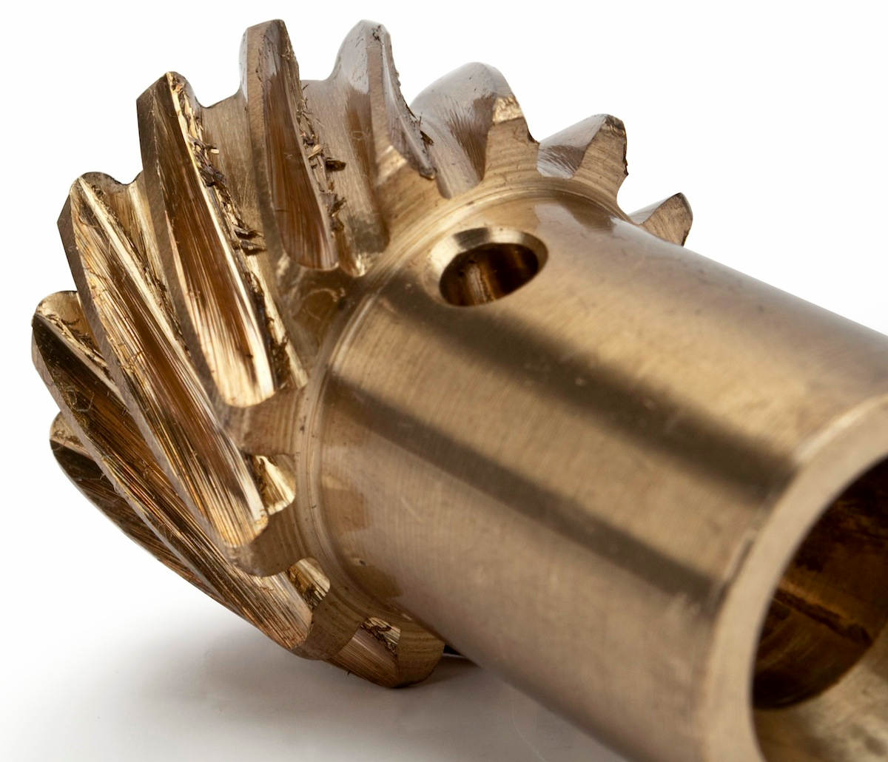
Improvement on Particle Filter: Variants
Extended Kalman PF (EKPF)
Particles sampled from a normal distribution that is generated by EKF
Introduction of EKF move particles toward high likelihood area
Markov Chain Monte Carlo (MCMC)
Sampling particles by constructing a Markov Chain through a kernel-based transition
Resampling according to Gibbs or Metropolis rule
Unscented PF (UPF)
Particles sampled from UKF generated normal distribution
Stronger capability in handling nonlinearity than EKPF
Regularized PF (RPF)
Create a continuous approximation of posterior PDF for resampling
Continuous PDF is converted from discrete PDF using a Epanechnikov kernel
Improving
Sampling
Improving Resampling
Gaussian-Hermite PF (GHPF)
Particles sampled from a normal distribution through Gaussian Hermite integration
Better accuracy than EKPF
Auxiliary PF (APF)
Switch the order of sampling and resampling
An auxiliary variable introduced to label particles with high likelihood

Slide 13
MCMC PF
Improvement built upon standard resampling
Particles resampled from a Markov chain (by adding noises to existing samples); newly particles are accepted if they have better likelihood than the old particles
Weight Update
Standard Resampling
Determining Acceptance
End of Resampling
Prediction
Resampling
Higher likelihood
Yes, keep the newly resampled particle
No, remain the old sample
Observation
Time
k-1
k-1
k-1
k
Weight
1/N
1/N
w_{k-1}
1/N
1/N
1/N

Slide 14
Regularized PF
Improvement built upon standard resampling
Particles resampled from a continuous distribution (constructed through kernels) instead of discrete positions
Prediction
Weight Update
Standard Resampling
Kernel Construction
Resampling
Observation
Kernel
Time
k-1
k-1
k-1
k
Weight
1/N
1/N
w_{k-1}
1/N
1/N
1/N
Musso, Improving regularized PF, Sequential MC Methods in Practice, 2001

Slide 15
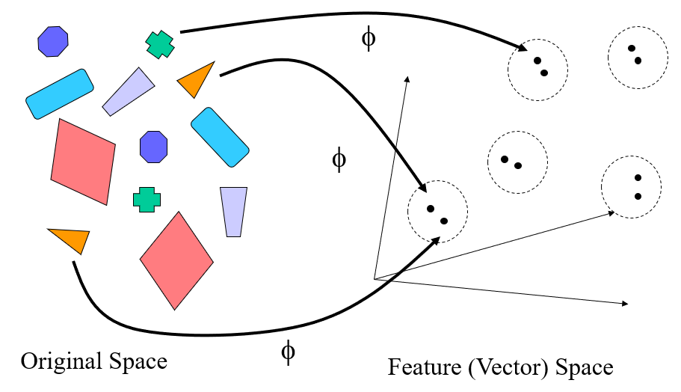
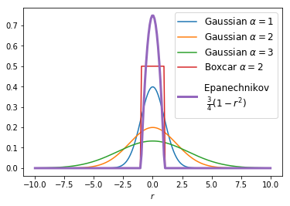
Regularized PF: Kernels
Intuitive idea
Find a mapping Φ such that, in the new feature space, problem solving is easier (e.g. nonlinear to linear)
Easy generalization of dot-product (or distance, represents the similarity between objects) based pattern recognition algorithms
Commonly used kernels in Regularized PF
Gaussian kernel
Epanechnikov kernel

Slide 16
Numerical Study and Performance Comparison
For PF and its variants, 20 particles are used

Slide 17
Numerical Study and Performance Comparison
 | EKF | UKF | PF | RPF | MCMC-PF
RMS | 6.11 | 4.87 | 5.98 | 2.11 | 2.51

